Slide 1
Recap from Probability and Statistics: Continuous
Random Variables

Slide 2
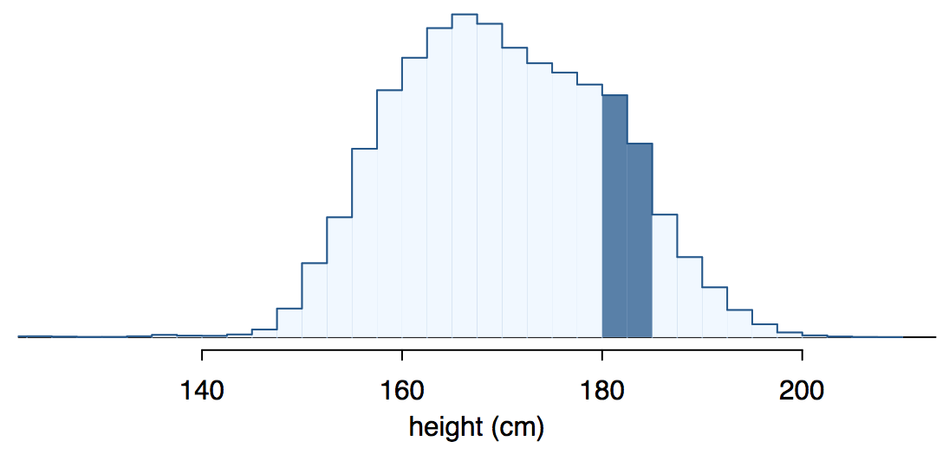
Continuous random variables
Below is a histogram of the distribution of heights of US adults.
The proportion of data that falls in the shaded bins gives the probability that a randomly sampled US adult is between 180 cm and 185 cm.

Slide 3
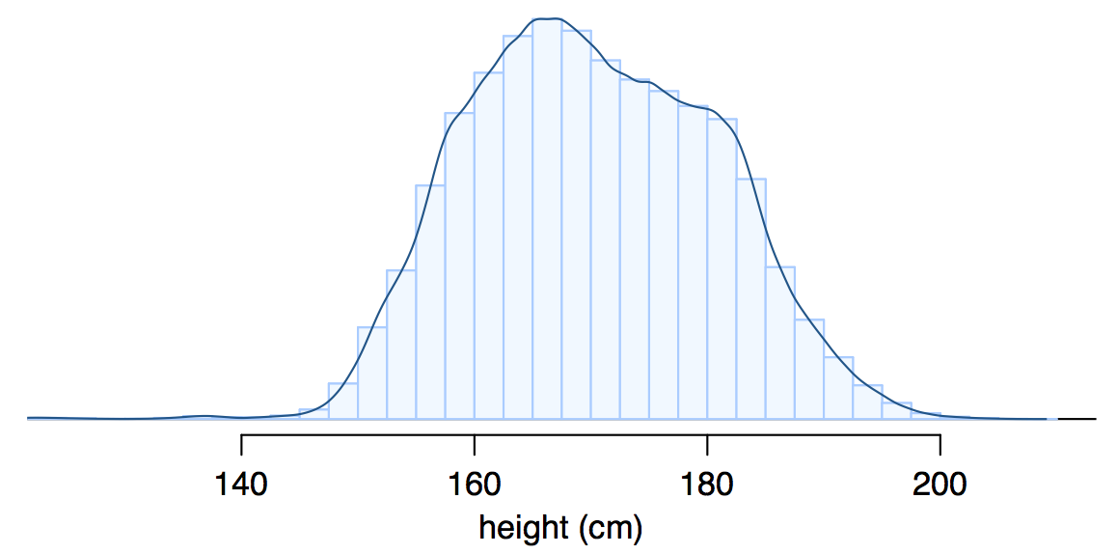
From histograms
to continuous distributions
Since height is a continuous numerical variable, we can reduce the width of the bins, until we obtain a smooth curve representing the probability density function (pdf) of the height.

Slide 4
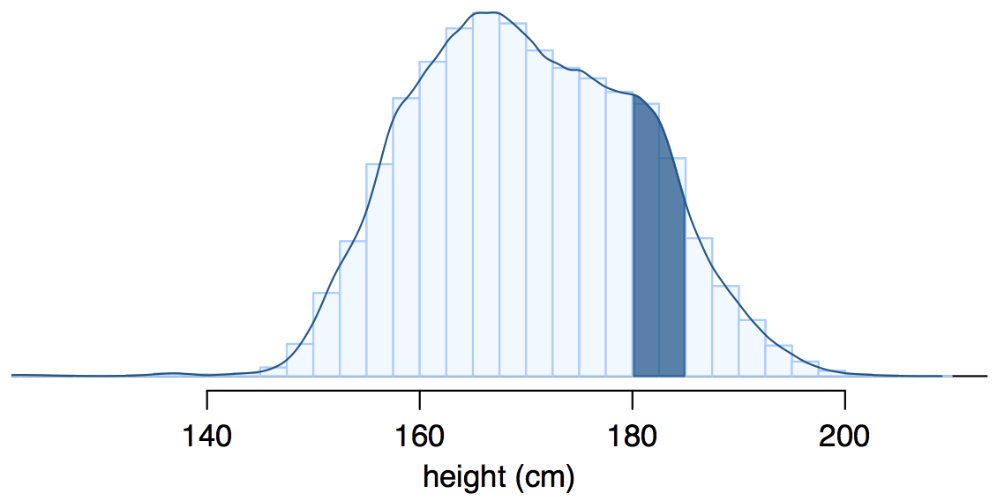
Probabilities from
probability density functions
Therefore, the probability that a randomly sampled US adult is between 180 cm and 185 cm is better estimated as the shaded area under the curve.

Slide 5
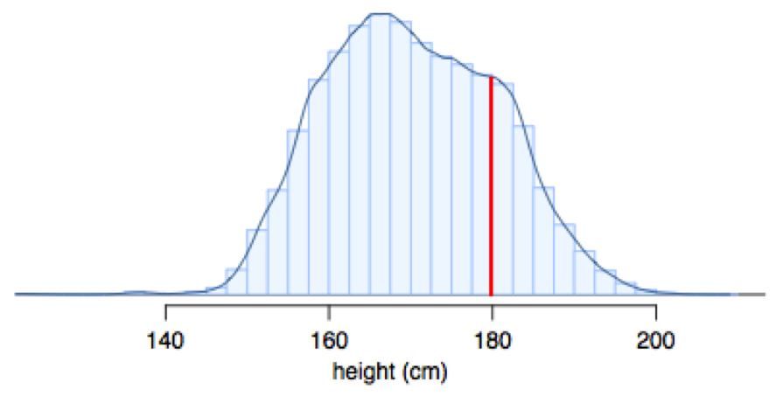
Probability density function
The pdf is a function f(X): R → [0,+∞] that describes the probability distribution of X.
P(a<X<b) can be computed as the area under f(X) between a and b.
The total area under f(X) has to be 1 (normalization constraint)
P(X=a) = 0
P(X≤a) = P(X<a)

Slide 6
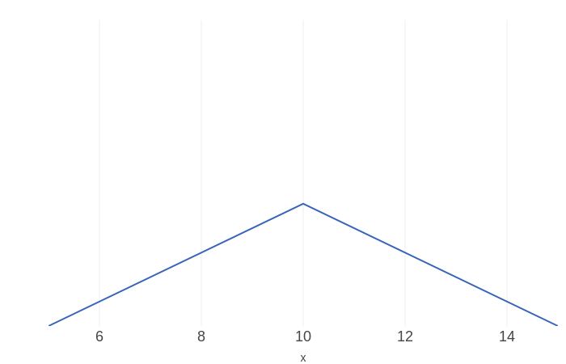
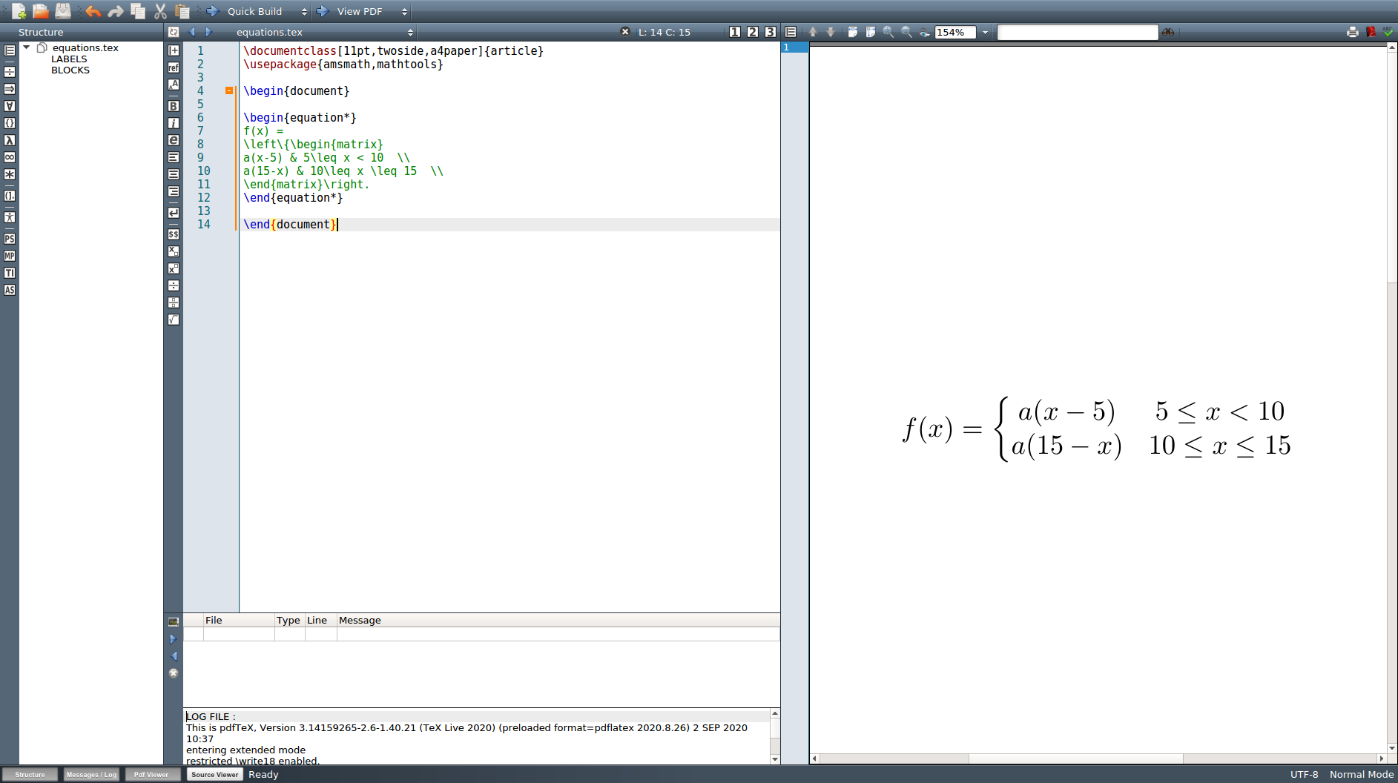
Probabilities from
probability density functions
The distribution of the time necessary to complete an exercise of math is described by the pdf f(x).
What is the value of a?
What is the probability that the exercise will take more than 12 minutes?

Slide 7
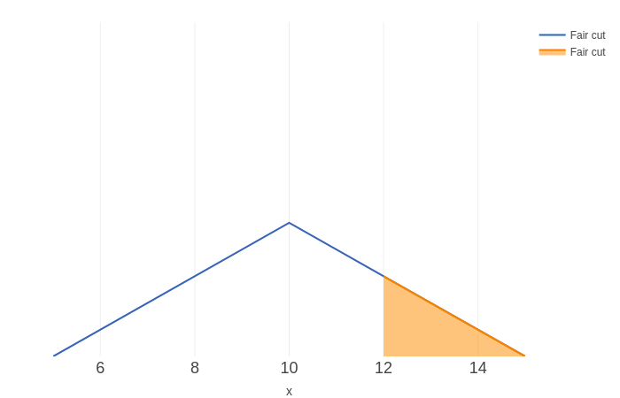
Probabilities from
probability density functions
The distribution of the time necessary to complete an exercise of math is described by the pdf f(x).
What is the value of a?
What is the probability that the exercise will take more than 12 minutes?
The total area under the curve has to be 1.
AREA = 10⋅5⋅a⋅(1/2) = 1 → a = 1/25
The probability of taking more than 12 minutes to complete the exercise corresponds to the orange area under the curve:
P(X>12) = 3⋅(1/25)⋅(15-12)⋅(1/2) = 9/50 = 0.18

Slide 8
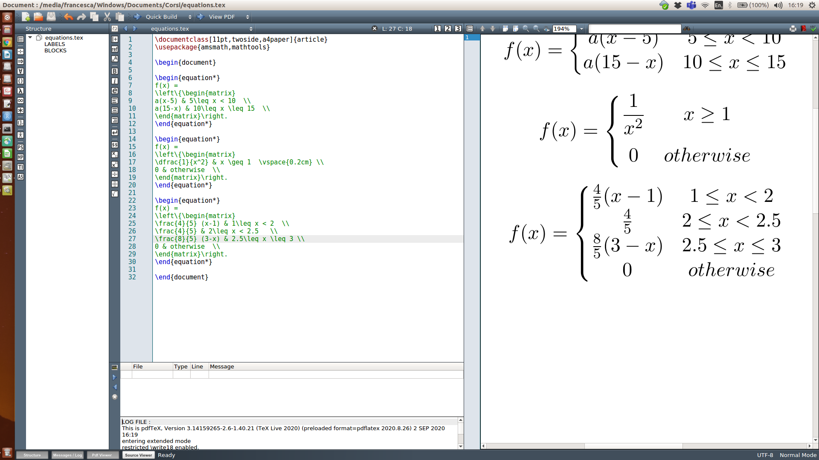
Practice
The rv X has the pdf f(x):
Check the normalization constraint
Compute P(X≤2)
Compute P(X>2.5)
Compute P(X≤2|X>2.5)
Compute P(X≤2.5|X>2)

Slide 9
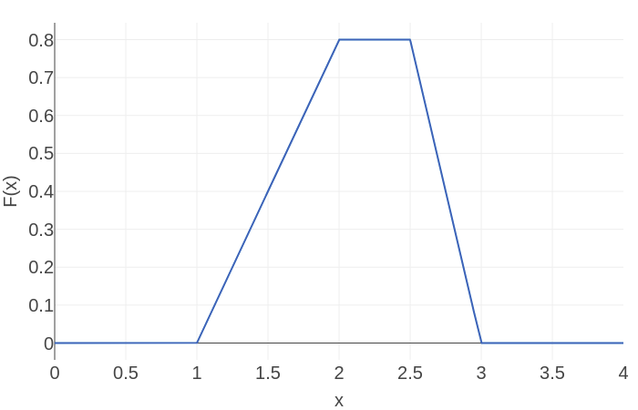
Practice
Check the normalization constraint The area under the curve has to be equal to 1. It can be computed as the sum of the red and blue triangles and the yellow rectangle: 0.4+0.4+0.2 = 1
Compute P(X≤2) area of the red triangle = 1*0.8/2 = 0.4
Compute P(X>2.5) area of the blue triangle = 0.5*0.8/2 = 0.2
Compute P(X≤2|X>2.5) = 0 since no value of X is larger than 2.5 and smaller than 2 at the same time
Compute P(X≤2.5|X>2) P(2<X≤2.5)/[1-P(X≤2)] = 0.4/0.6 = 2/3 where P(2<X≤2.5) = area of the yellow rectangle = 0.5*0.8 = 0.4

Slide 10
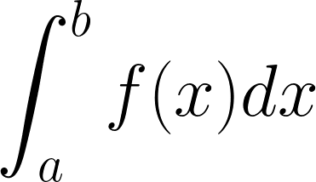
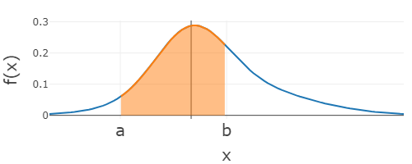
Areas and integrals
In general, the area under the curve described by function f(x) can be computed using the notion of integral that you will study in analysis.
The following notation represents the integral between a and b of f(x)
If f(x)≥0 for all x∈R, it corresponds to the area delimited by f(x), the x axis and the vertical lines x = a and x = b.

Slide 11
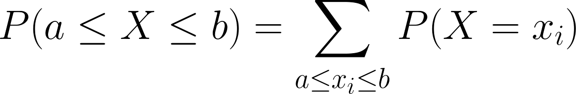
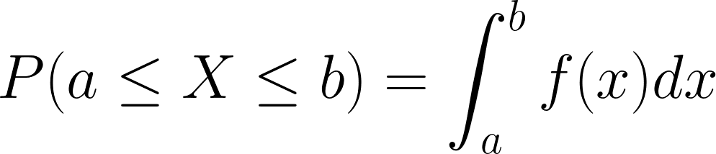
Summation and integrals
Notice that the probability a≤X≤b
is a summation over the possible values between a and b in case X is a discrete rv:
becomes an integral if X is continuous.

Slide 12
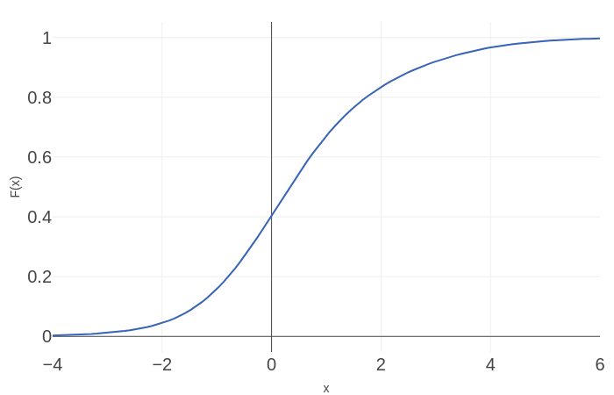
Cumulative distribution functions
The cumulative distribution function (cdf), usually named with an uppercase letter, e.g., F(x), is a function F(x): R→ [0,1] which associates to each x its cumulative probability P(X≤x).
F(x) is a non decreasing function
F(-∞) = 0, F(+∞)=1

Slide 13
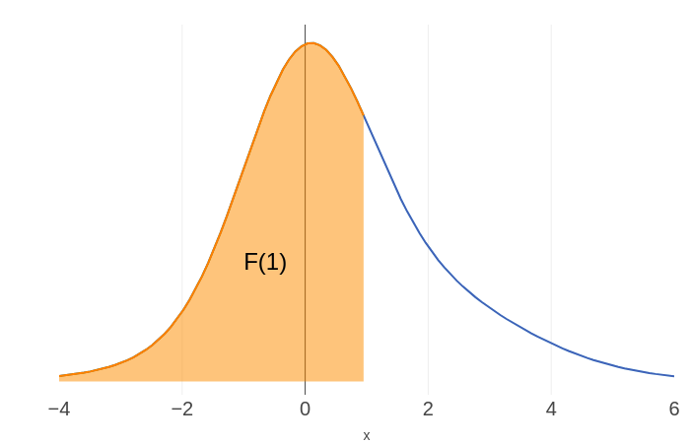
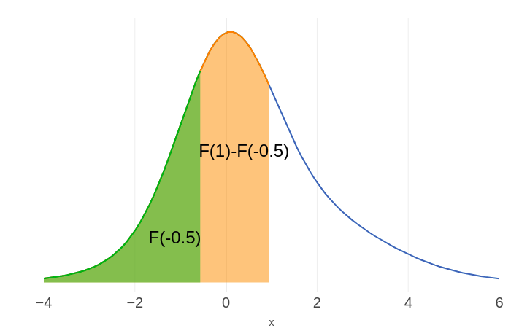
Cumulative distribution functions
The cumulative distribution function (cdf), usually named with an uppercase letter, e.g., F(x), is a function F(x): R→ [0,1] which associates to each x its cumulative probability P(X≤x).
F(x) is a non decreasing function
F(-∞) = 0, F(+∞)=1
F(x) correspond to the area under the pdf from -∞ to x
P(a<X≤b) = F(b)-F(a)

Slide 14
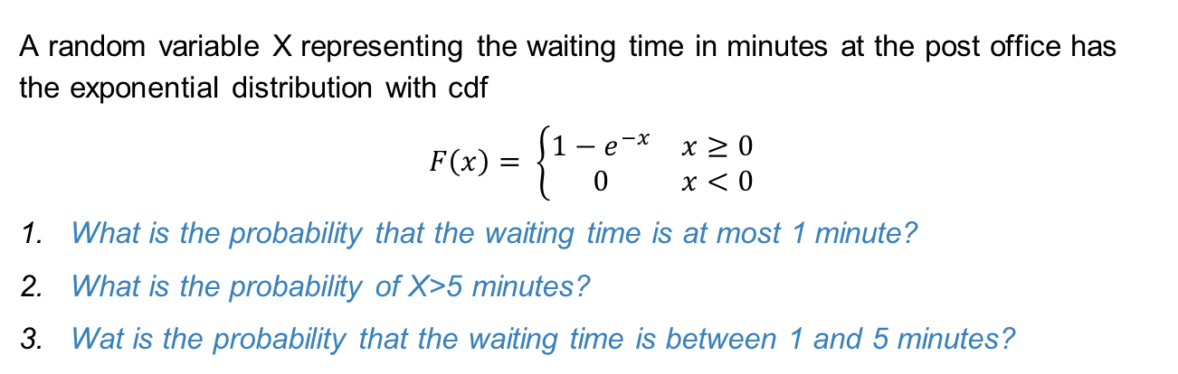
Example
A random variable X representing the waiting time in minutes at the post office has the exponential distribution with cdf
$$F\left(x\right)= \left\{\begin{matrix}1−ⅇ^{−x} & x≥0 \\ 0 & x<0\end{matrix}\right.$$
What is the probability that the waiting time is at most 1 minute?
What is the probability of X>5 minutes?
Wat is the probability that the waiting time is between 1 and 5 minutes?

Slide 15
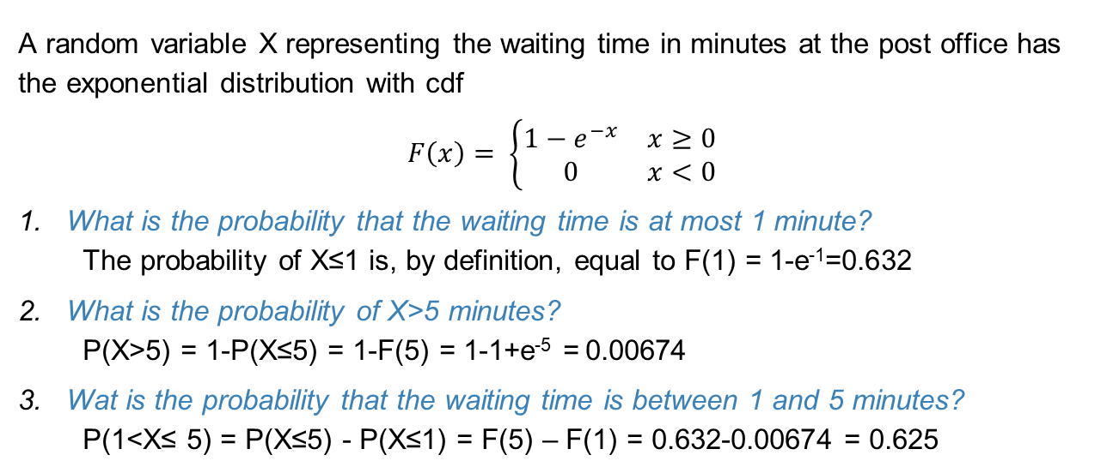
Example
A random variable X representing the waiting time in minutes at the post office has the exponential distribution with cdf
$$F\left(x\right)= \left\{\begin{matrix}1−ⅇ^{−x} & x≥0 \\ 0 & x<0\end{matrix}\right.$$
What is the probability that the waiting time is at most 1 minute?
The probability of X≤1 is, by definition, equal to F(1) = 1-e⁻¹=0.632
What is the probability of X>5 minutes?
P(X>5) = 1-P(X≤5) = 1-F(5) = 1-1+e⁻⁵ = 0.00674
Wat is the probability that the waiting time is between 1 and 5 minutes?
P(1<X≤ 5) = P(X≤5) - P(X≤1) = F(5) – F(1) = 0.632-0.00674 = 0.625

Slide 16
Uniform distribution
What are the pdf and the cdf of a random variable X uniformly distributed between a and b?

Slide 17
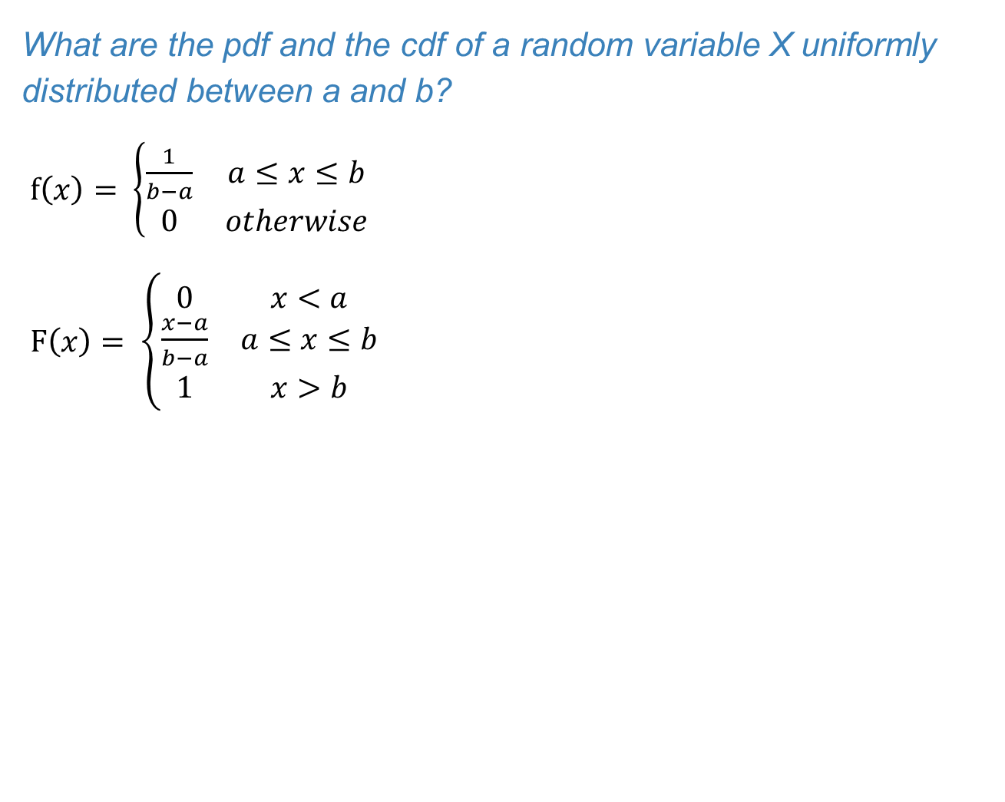
Uniform distribution
What are the pdf and the cdf of a random variable X uniformly distributed between a and b?
$f\left(x\right)= \left\{\begin{matrix}\frac{1}{b−a} & a≤x≤b \\ 0 & otherwise\end{matrix}\right.$
$F\left(x\right)= \left\{\begin{matrix}0 & x<a \\ \frac{x−a}{b−a} & a≤x≤b \\ 1 & x>b\end{matrix}\right.$
f(x)
1/(b-a)
Total area=1
F(x)
1-F(x)
a
x
b
F(x)
1
a
x
b

Slide 18
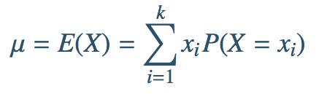
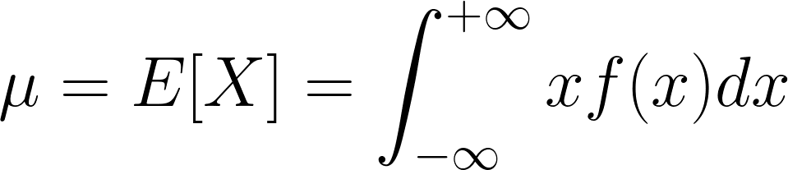
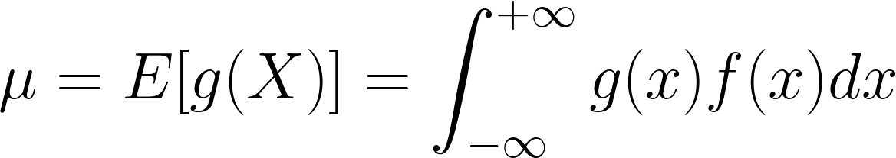
Expected value of a continuous rv
For a discrete rv we have
For a continuous rv, the summation becomes an integral:
Analogously, the expected value of a function g(X) of X is

Slide 19
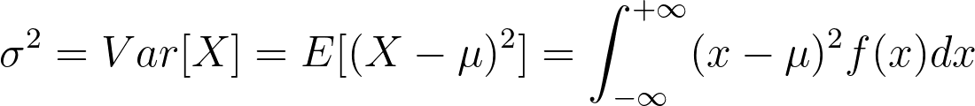
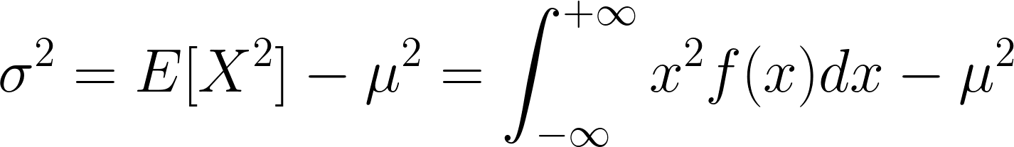

Variance of a continuous rv
The variance of a continuous rv is:
It also holds
The standard deviation is still

Slide 20



Expected value and variance of the uniform distribution
E[X] = (a+b)/2
Var[X] = (b-a)²/12
$σ =(b−a)/\sqrt{12}$
1/(b-a)
$$σ$$
$$σ$$
a
µ
b

